Slide 1
Used Car Price Prediction
Team Members:
Sai Charith Govardhanam
Yashwant Bhaidkar
Lakshmi Sravya Chalapati
Manojkumar Yerraguntla

Slide 2

SMART question: Which factors are important in the prediction of resale price of the car?

Slide 3
AGENDA
In the previous presentation, we have seen how to perform EDA for the SMART questions.
Now in this presentation we are going to do different types of Feature Selection Methods:
Boruta Method
Random Forest Regressor
MARS Method
Step Wise Regression
We are also going to perform different modeling methods in this :
Linear Regression
Lasso and Ridge Regression
SVM Regressor
Random Forest and XGBoost

Slide 4

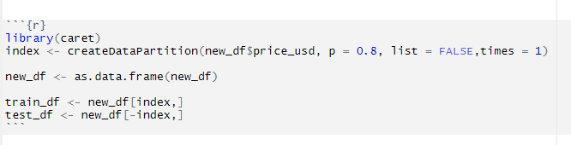

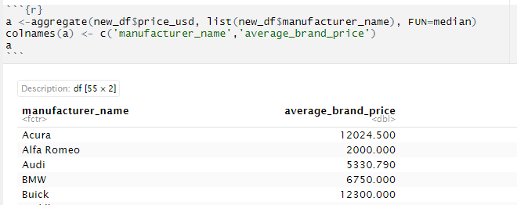
Data Pre-processing and Splitting:
Scaling of numerical features and creating factors
for the categorical features
Splitting dataset into train and test subset
Dataset is divided as 80% of the data is considered
as a training Dataset and 20% of the data is for testing the model accuracy.
Converting multi categorical feature into numerical

Slide 5
Feature Selection Methods

Slide 6
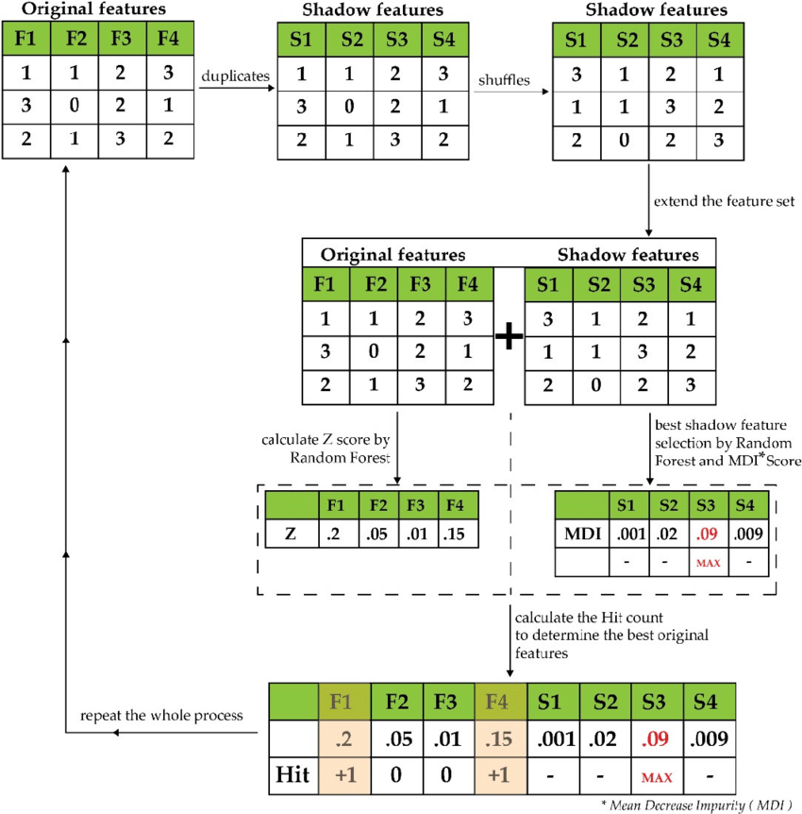
Boruta Method:
Boruta is a wrapper method of the Feature selection built around the Random Forest Classifier algorithm.
The feature with more number of Hits at the end of all iterations will used for building the model.

Slide 7

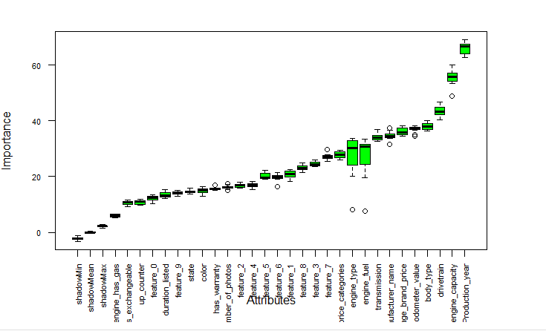
Boruta Method: Results
Code Chunk for Boruta Method:
Graph of Boruta Method:
Results of Boruta Method:

Slide 8

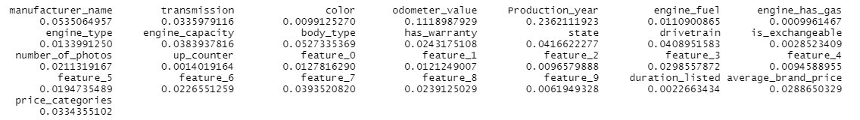
Random Forest Algorithm for Feature selection
There are two ways to perform feature selection with random forest:
cforest(From party library): Gives the variable importance based on variance.
As we can clearly see that some features like production_year, manufacturer_name, odometer_value, transmission and body_type are individually explaining the variance better.
Unknown feature_7 is explaining the variance better compared to other features.

Slide 9
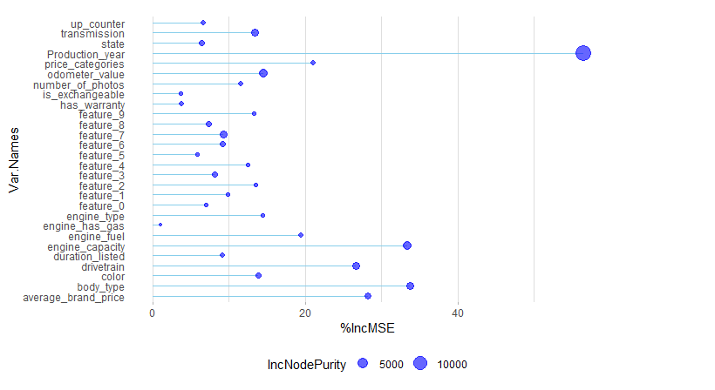
Feature Selection Using Random Forest Algorithm
Model fitting:
Production_year, Engine_capacity, drivetrain, body_type and average brand price are the most important features in the prediction of resale car prices
Some features like is_exchangeable, state and engine_has_gas are not important compared to other features.

Slide 10
MARS Method:
Multivariate adaptive regression splines (MARS) can be used to model nonlinear relationships
between a set of predictor variables and a response variable.
This method works as follows:
Divide a dataset into k pieces.
Fit a regression model to each piece.
Use k-fold cross-validation to choose a value for k.

Slide 11
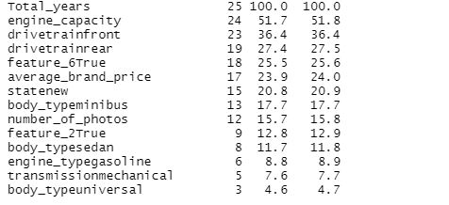
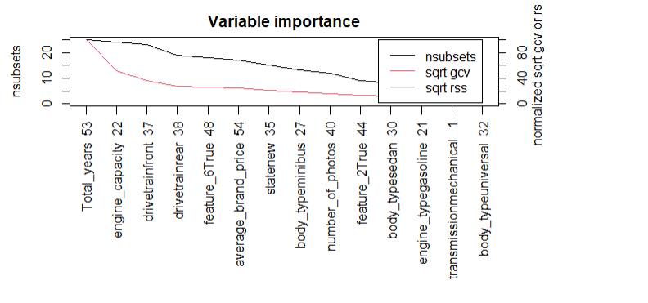
MARS Method: Results
variable importance based on Generalized cross validation (GCV), number of subset models the variable occurs (nsubsets) and residual sum of squares (RSS).
Using MARS method, Total_Years, engine_capacity,drivetrain, Unknown_feature_6 are the important features.

Slide 12
Step Wise Regression Method:
Step wise regression model is a procedure we can use to build a regression model from a set of predictor variables by entering and removing predictors in a stepwise manner into the model until there is no statistically valid reason to enter or remove any more.
The goal of stepwise regression is to build a regression model that includes all of the predictor variables that are statistically significantly related to the response variable.
There are three strategies of stepwise regression:
Forward selection - starts with no predictors
Backward selection - starts with all predictors
Stepwise selection - combination of both forward and backward selections

Slide 13
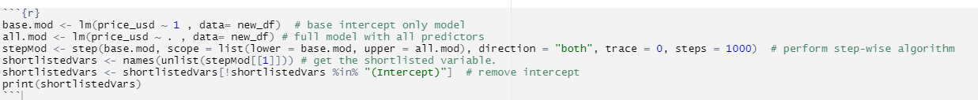
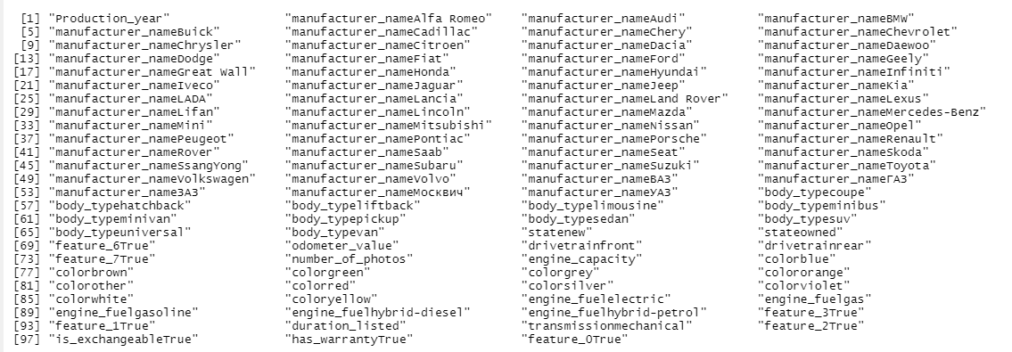
Step Wise Regression Method: Results
start with no predictors-sequentially add the most contributive predictors. After adding each new variable, remove any variables that no longer provide an improvement in the model fit.
The features above are in the order of their importance for the model

Slide 14
Predictive Modeling

Slide 15
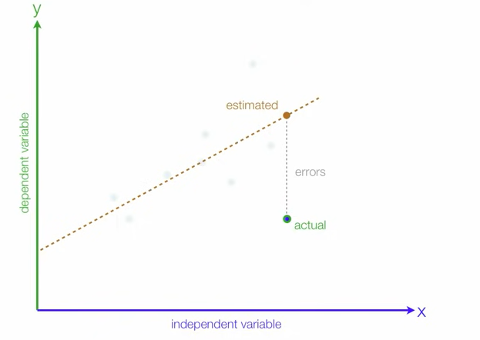
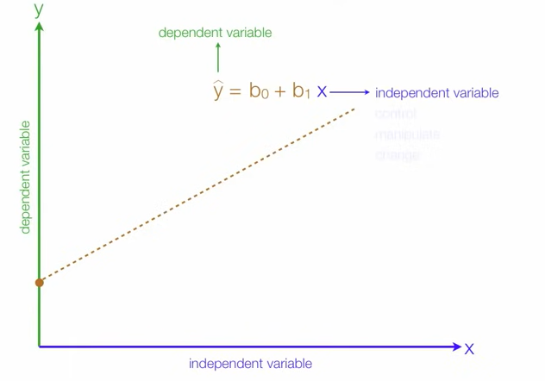
Linear Regression Model:
Linear regression is a linear approach for modelling the relationship between a scalar response and one or more explanatory variables.
Mathematical Equation: y =b0+b1x
b0: Intercept of the line
b1: Regression Coefficient

Slide 16
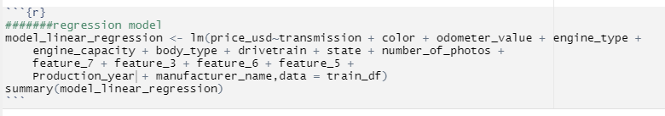
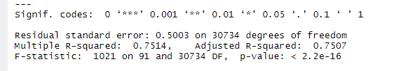
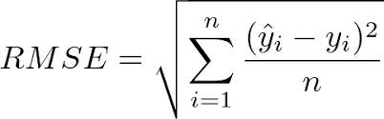
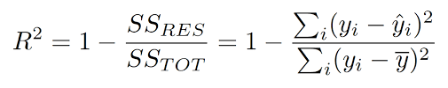
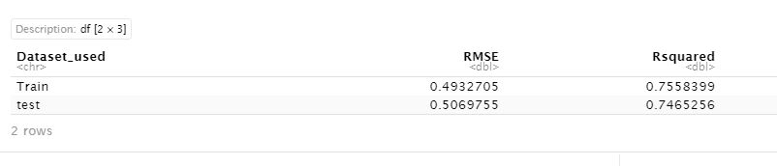

Linear Regression model: Results
R-Squared Value: It means this model can explain 75% of variation in price of the used car.
Standard Formulas:

Slide 17

Lasso Regression:
LASSO is short for Least Absolute Shrinkage and Selection Operator which is used for both regularization and model selection.
This method is usually used in machine learning for the selection of the subset of variables.
It provides greater prediction accuracy as compared to other regression models.
Lasso Regularization helps to increase model interpretation.
Which is the same as minimizing the sum of squares with constraint Σ |B_{j}≤ s. Some of the βs are shrunk to exactly zero, resulting in a regression model that’s easier to interpret.
A tuning parameter, λ controls the strength of the L1 penalty. λ is basically the amount of shrinkage:
When λ = 0, no parameters are eliminated. The estimate is equal to the one found with linear regression.
As λ increases, more and more coefficients are set to zero and eliminated (theoretically, when λ = ∞, all coefficients are eliminated).
As λ increases, bias increases.
As λ decreases, variance increases.

Slide 18
Ridge Regression:
Ridge regression is a model tuning method that is used to analyze any data that suffers from multicollinearity. This method performs L2 regularization.
When the issue of multicollinearity occurs, least-squares are unbiased, and variances are large, this results in predicted values being far away from the actual values.
Min (||Y – X (theta) ||^2 + λ||theta||^2)
Lambda is the penalty term.
λ given here is denoted by an alpha parameter in the ridge function.
So, by changing the values of alpha, we are controlling the penalty term. The higher the values of alpha, the bigger is the penalty and therefore the magnitude of coefficients is reduced.
It shrinks the parameters. Therefore, it is used to prevent multicollinearity.
It reduces the model complexity by coefficient shrinkage.

Slide 19
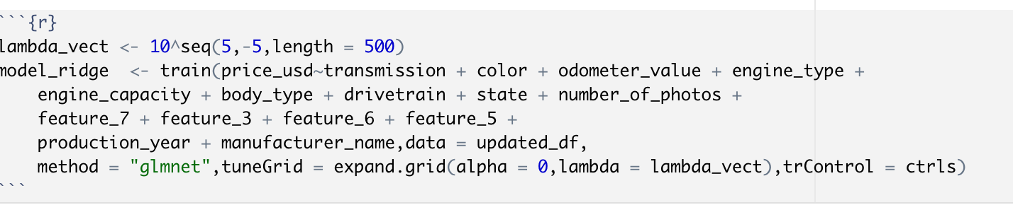
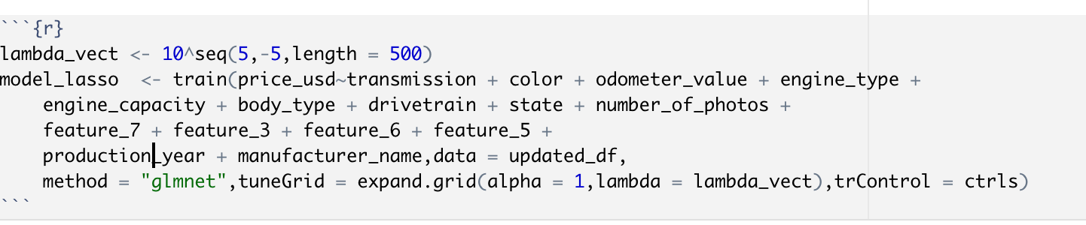
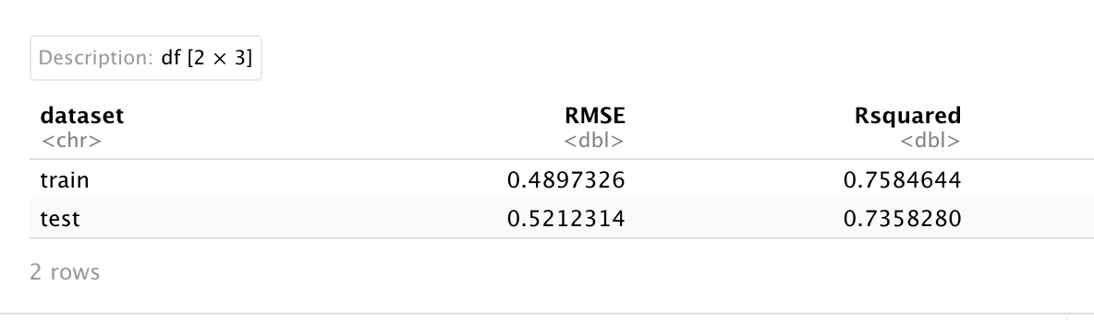
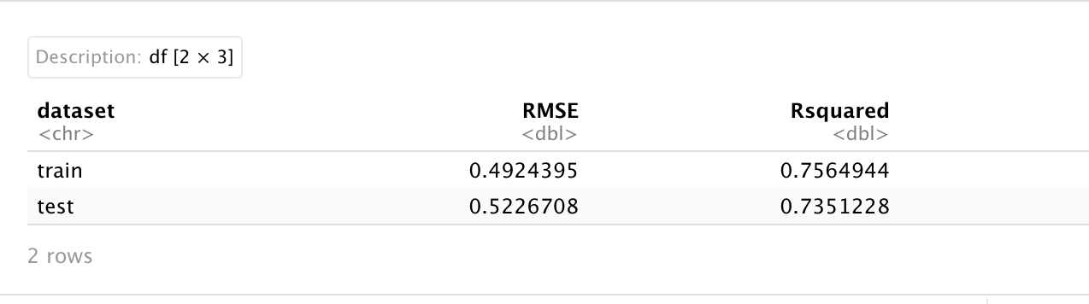
Ridge Results Lasso Results
The same function glmnet( ) with alpha set to 1 will build the Lasso regression model

Slide 20
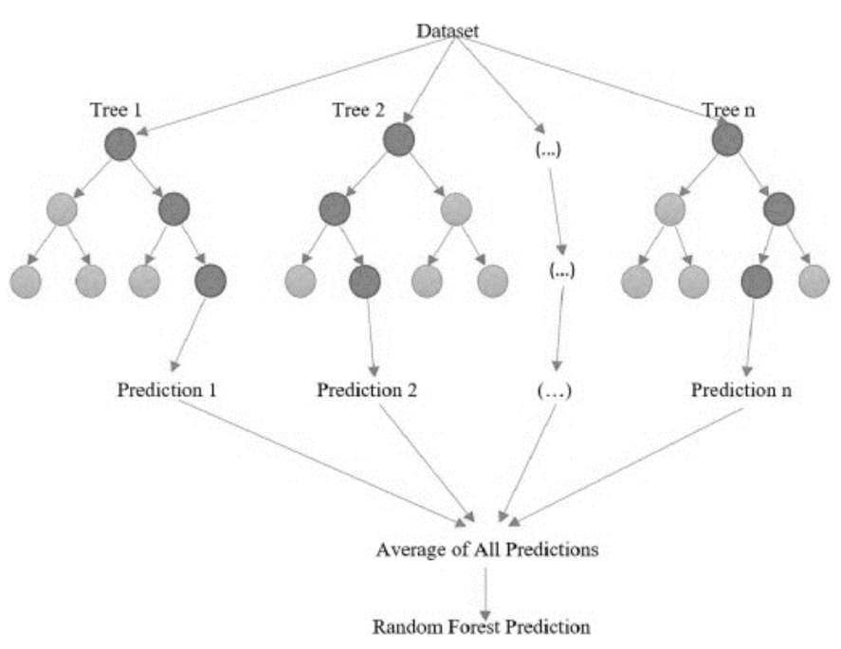
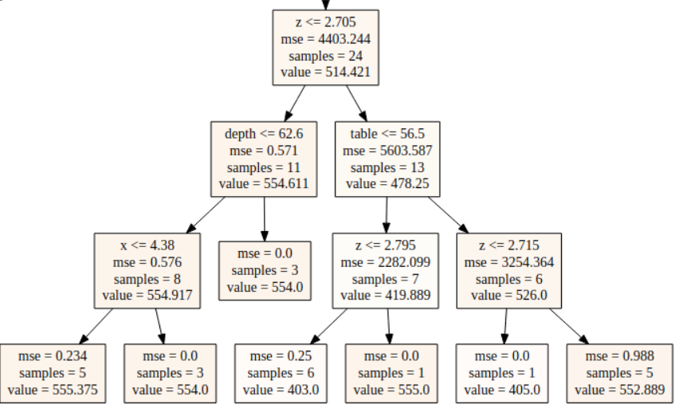
Random Forest Regressor
Random forest is a decision tree-based algorithm that uses the bagging(Bootstrap Aggregation)
technique to reduce the variance of the model.
Random forest Regressor – Visualization
Decision Tree Example(Base Lerner)
Bootstrapping
Aggregation

Slide 21
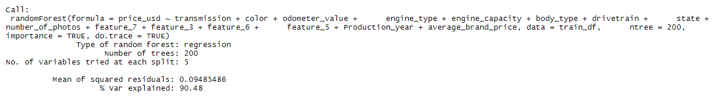
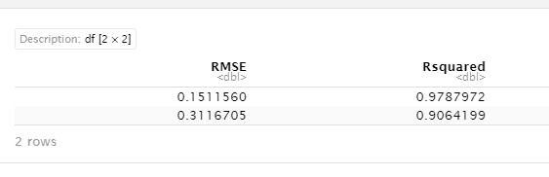
Random Forest Regressor: Results
Using an iterative algorithm, we got the best value for the number of trees as 200 and the test Rsquared value for the best RF model is 90.64%.

Slide 22
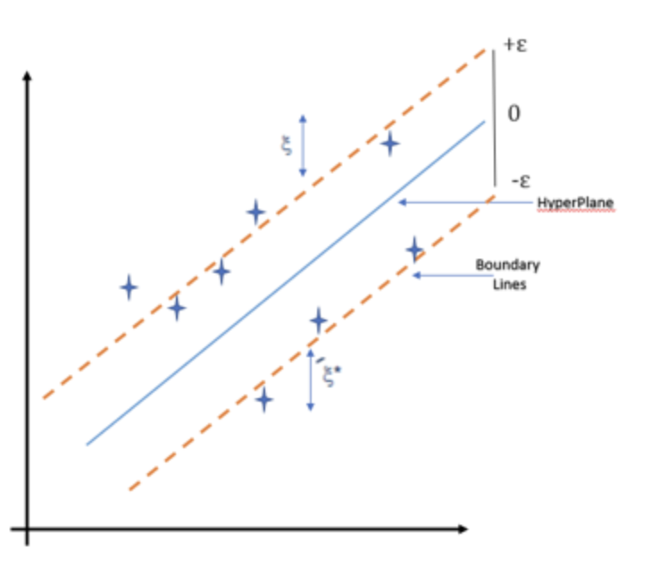
SVM Regressor:
Support Vector Machine can also be used for regression problem wherein dependent, or target variable is continuous.
The goal of SVM regression is same as classification problem i.e. to find maximum margin. Here, it means minimize error.
In the case of regression, a margin of tolerance (epsilon) is set in approximation to the SVM.
The primary goal is to minimize error, individualizing the hyperplane which maximizes the margin, keeping in mind that part of the error is tolerated.

Slide 23
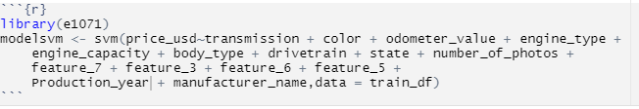
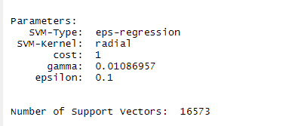
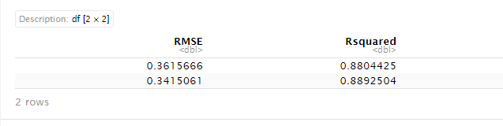
SVM Regressor: Results
Svm model is passed with the best features .
The RMSE and Rsquared values for the test ad train data is shown

Slide 24
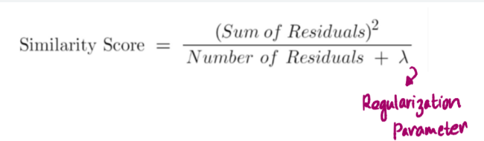
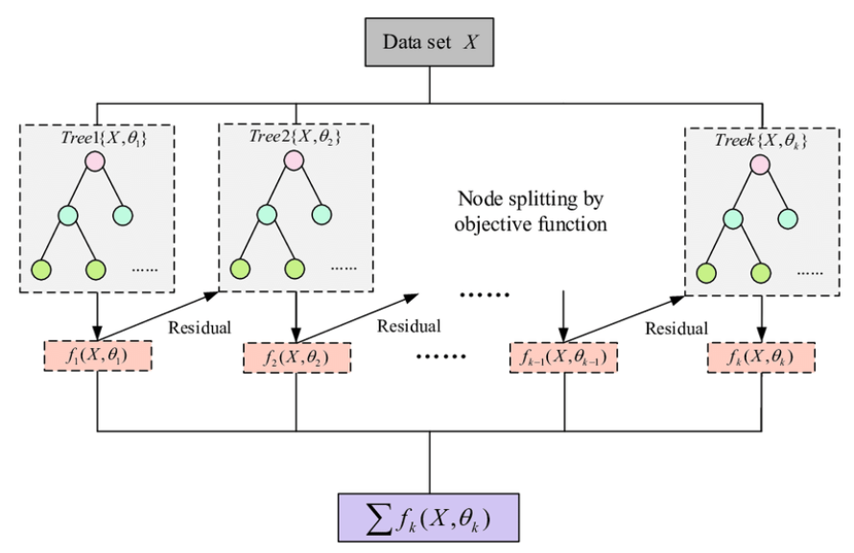
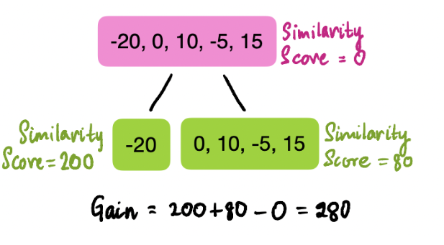
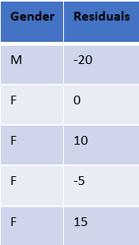
XGBoost Regressor – Intuition
XGBoost Regressor is one of the ensemble techniques which is based on the boosting mechanism.
XGBoost Mechanism
Calculating gain using similarity score
M
F

Slide 25
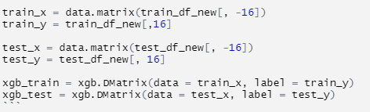

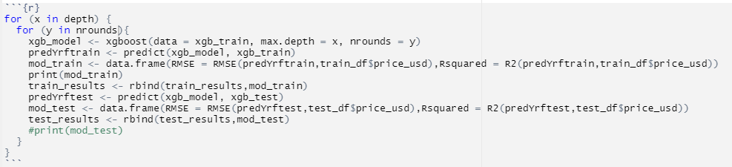
XGBoost Regressor with Hyperparameter Tuning
Using the hyperparameter tuning method we got the model with max_depth 4 and nrounds = 600 is giving the maximum Rsquared value and Minimum root mean squared error.
Passing range for hyperparameter Tuning
Matrix Transformation for training and test data
An iterative algorithm to find the best value of depth and nrounds

Slide 26
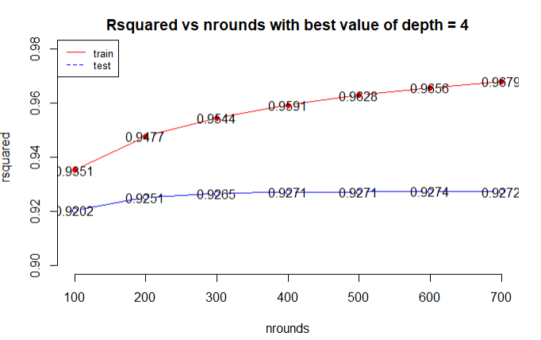
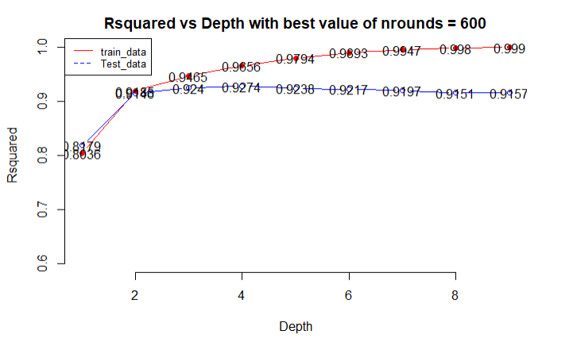
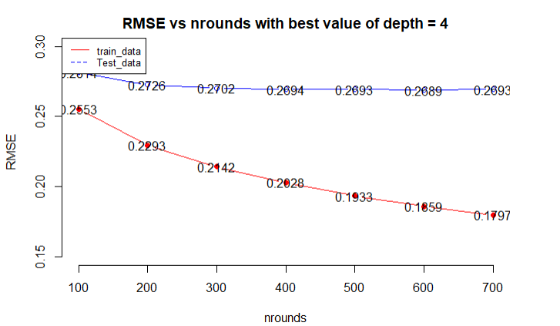
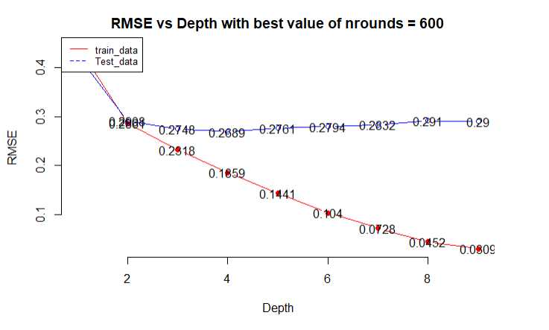
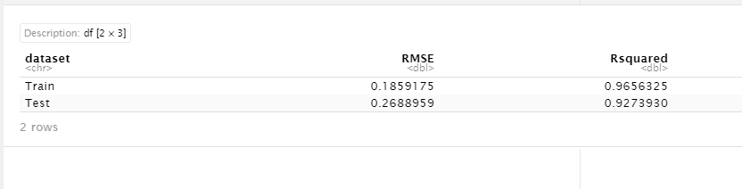
XGBoost – Best model selection with Hyperparameter Tuning

Slide 27
Summary of Model Results:
Model(Algorithm) | R-squared(Train) | R-squared(Test) | RMSE(Train) | RMSE(Test)
Linear Regression | 75.58% | 74.65% | 0.4933 | 0.5070
Lasso Regression | 75.84% | 73.58% | 0.4897 | 0.5212
Ridge Regression | 75.64% | 73.51% | 0.4924 | 0.5226
SVM Regressor | 88.04% | 88.92% | 0.3615 | 0.3415
Random Forest Regressor | 97.87% | 90.64% | 0.1511 | 0.3116
XGBoost Regressor | 96.56% | 92.73% | 0.1859 | 0.2688
The linear regression model performed significantly well and there is not much difference observed in the case of lasso and Ridge.
Bagging and boosting regressors did very well and we got test R-squared above 90% with minimum RMSE compared to other models.

Slide 28
THANK YOU

